Slide 1



The Importance of Statistics in Volleyball
Parker Booth

Slide 2
Introduction
University of Utah’s volleyball team finished the 2023 season with a record of 11 - 19
15 - 16 in 2022 & 22 - 9 in 2021
Questions to Answer:
What volleyball game statistics are essential to winning?
What movements are vital for success in both practice and games?
The importance of kills in volleyball games
Four different relationships modeled using Stan
2 Logistic Regressions & 2 Robust Linear Regressions
Notes:
Want to know why decline from last season

Slide 3
Data
Volleyball game statistics are aggregated as all statistics recorded by the team each match
Opponent game statistics were recorded as well
The practice and movement data highlights the eight critical players on the team throughout all practices and game days
All data is collected in an applied setting
Practice and movement data is collected using Catapult IMUs
Metrics such as training load and jump statistics are relevant
Notes:
Players wear catapult vests in practices and games
IMU – Inertial Measurement Unit

Slide 4
Data Description
Kill %: Percentage of attacks that directly lead to a point
Kill % Differential: Difference between Utah’s kill percentage and the opponent's kill percentage
High Jump %: Calculated by Catapult IMUs. Percentage of jumps classified as high
Setters’ medium jumps are relevant for this metric. Liberos & Defensive Specialists removed from this metric
All other positions calculated with high jumps
Player Load per Min: Calculated by Catapult IMUs. Player load is a metric that calculates the effort a given player exerts
Other metrics used:
Dig %, Attacking Error %, Serving Error %, Ace %
Notes:
Players wear catapult vests in practices and games
IMU – Inertial Measurement Unit
Setters do not need high jumps
Liberos & Defensive jumps are not important
Player load per minis calculated using accelerations
Dig: Defensive player blocks and attack
Att. Error: Misses attack by hitting out of bounds/net
Serve Error: Misses serve net or out of bounds
Ace: Serve leads to a point

Slide 5
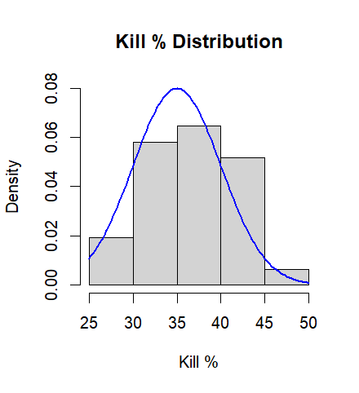
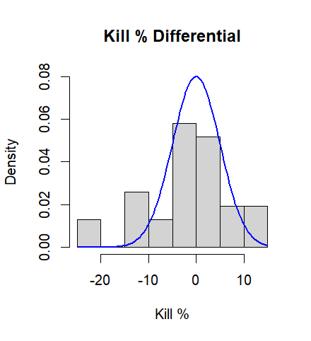
Prior Specifications
Sports statistics are commonly distributed around a mean with a low amount of outliers
Theoretically matches a normal distribution
Uniform priors do not fit well (Ace %)
Normal Distributions for all priors but Catapult metrics
Normal priors gave unrealistic results for movement metrics
Different priors were tried that gave different results
Exponential & Truncated Normal
Notes:
Truncated normal = normal. (Converged to each other)
Uninformative priors for catapult data
Exponential results were bad
Ace % with a uniform prior is completely unrealistic
100% of all serves are aces = 0%?
Not a good specification

Slide 6
Model 1: Logistic Regression
Logistic Model of Important Volleyball Statistics on a Dichotomous Win Variable
Win Dummy ~ Bernoulli Logit(Kill% + Attack Error% + Serve Error% + Ace% + Dig% )
Observations = 31; Iterations = 10,000; Chains = 3;
Priors:
Kill % ~N(35, 5); Attack Error % ~ N(8, 2); Dig % ~ N(65, 5); Serve Error % ~ N(12, 4); Ace % ~ N(8, 4)
Shows which metrics are the most impactful on winning volleyball games

Slide 7
Stan Output
Rhats all equal 1
n_eff large for most parameters
Coefficients defined in log odds
Kill % has the largest impact on winning
Both in the point estimate in the 95% probability interval
Both error metrics are negative
Almost fully negative intervals
Dig % & Ace % are positive
Dig % is fully positive
Ace % not entirely determined
Parameter | mean | se_mean | sd | 2.5% | 97.5% | n_eff | Rhat
Intercept | 49.47 | 0.26 | 20.52 | -95.28 | -16.36 | 6201 | 1
Kill % | 0.79 | 0.00 | 0.32 | 0.29 | 1.53 | 6878 | 1
Attack Error % | -0.52 | 0.00 | 0.33 | -1.23 | 0.07 | 13651 | 1
Dig % | 0.40 | 0.00 | 0.19 | 0.07 | 0.83 | 7264 | 1
Serve Error % | -0.40 | 0.00 | 0.24 | -0.93 | 0.01 | 9955 | 1
Ace % | 0.31 | 0.00 | 0.28 | -0.17 | 0.95 | 13657 | 1
Notes:
Ace % could be negative because of a lack of data

Slide 8
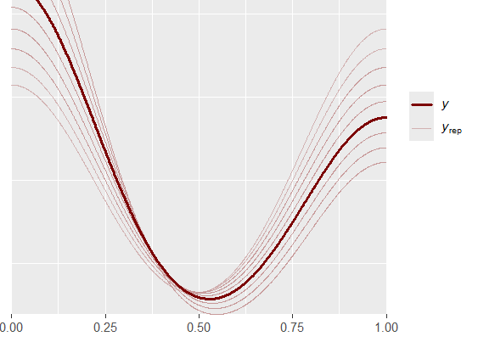
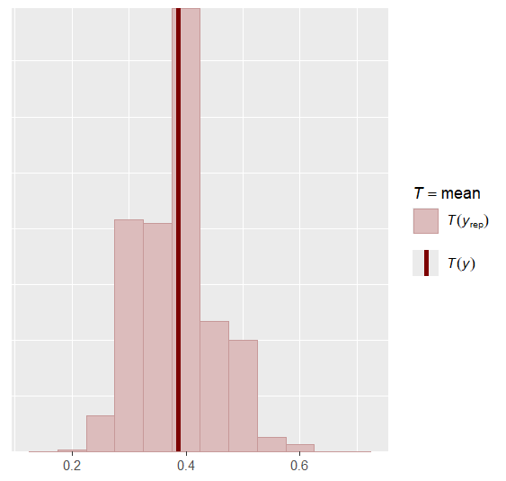
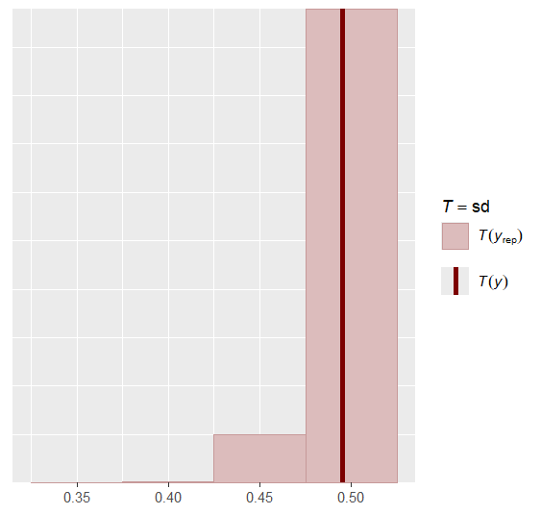
Posterior Predictive Checks
Generative data follows the distribution of the volleyball data
Also puts all weight on ones and zeros
Mean and standard deviation recovered well
Max and Min also recovered
Confirmed by generative data weighting
Mean distributed normally around a large center
Notes:
Mean distribution follows normal distribution somewhat
Weight on 1s and 0s grabs max/min

Slide 9
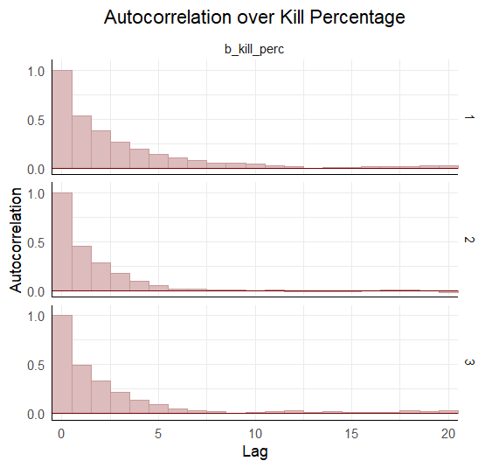
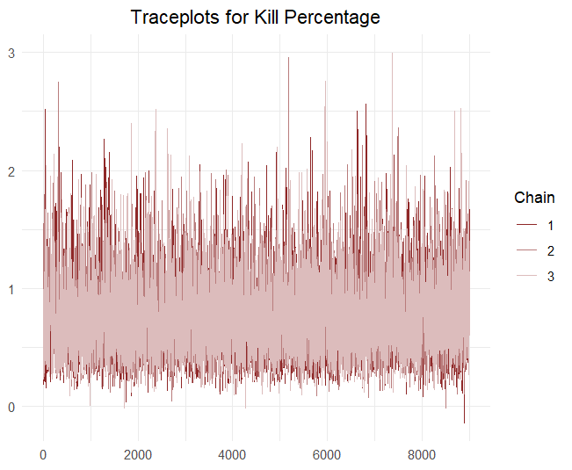
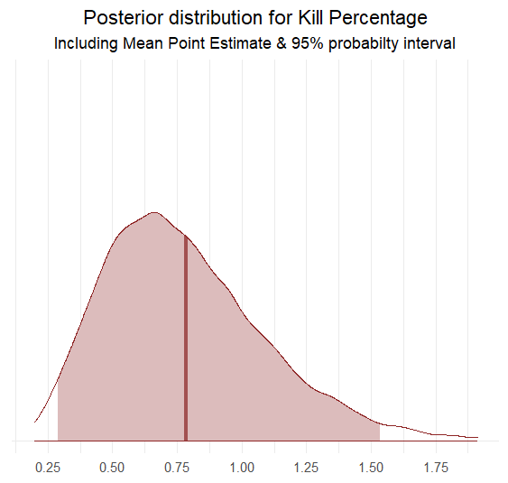
Model Checks
Autocorrelation dies out after approx. 5 periods
Trace plots show convergence and efficient sampling
Samples negative values only a few times
Coefficient on Kill % ranges from around 0.3 to 1.5
99% interval plotted; 95% interval highlighted
Purely positive

Slide 10
Model 2: Logistic Regression
Logistic Model of Kill % Differential on a Dichotomous Win Variable
Win Dummy ~ Bernoulli Logit(Kill_Diff)
Observations = 31; Iterations = 10,000; Chains = 3;
Priors: Kill Diff. ~ N(0,5);
Isolates the impact of kill percentage on winning
Kill differential considers both offensive and defensive aspects of the game
Is the team attacking efficiently and defending opposing attacks efficiently?
More telling metric than Kill %
Notes:
Now that we have shown kill % being the most important… Prior centered at 0 because of differential
Similar Regression
Isolation of impact

Slide 11

Stan Output
Parameter | mean | se_mean | sd | 2.5% | 97.5% | n_eff | Rhat
Intercept | -0.84 | 0.00 | 0.57 | -2.03 | 0.21 | 18392 | 1
Kill Differential | 0.38 | 0.00 | 0.14 | 0.16 | 0.70 | 15966 | 1
Same positive relationship exists between kill differential and winning
95% interval is fully positive
Rhats equal to 1 for both parameters
n_eff is high for both parameters

Slide 12
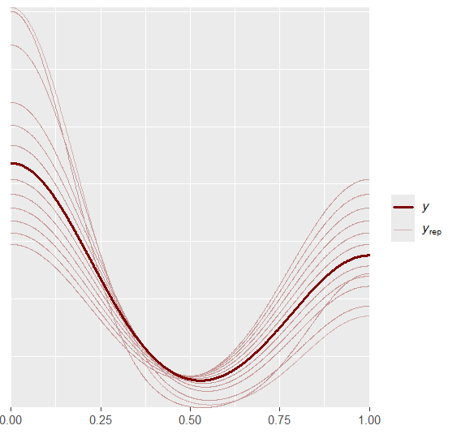
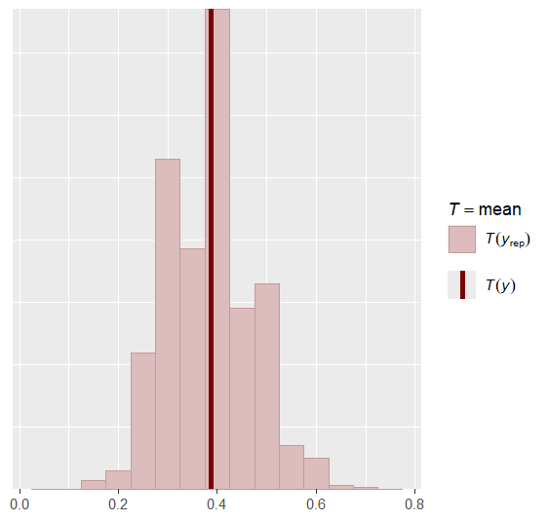
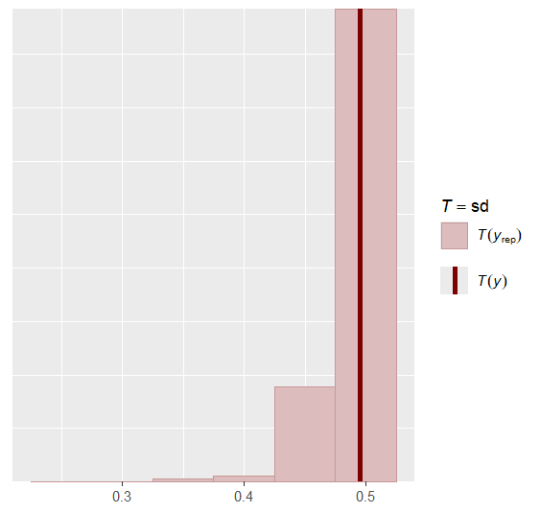

Posterior Predictive Checks
Generative data follows the distribution of the volleyball data
Again, puts all weight on ones and zeros
Mean and standard deviation recovered well
Max and Min also recovered
Confirmed by generative data weighting
Mean distributed somewhat normally

Slide 13
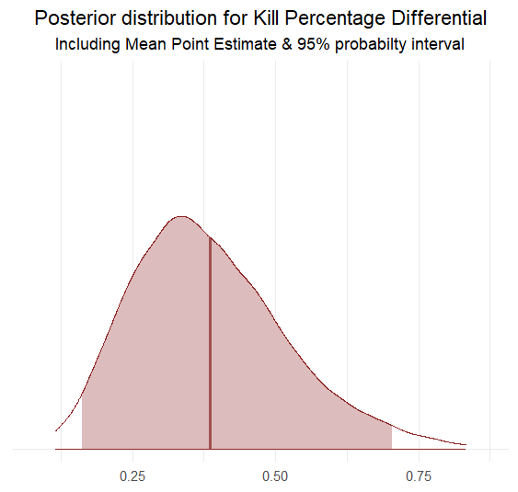
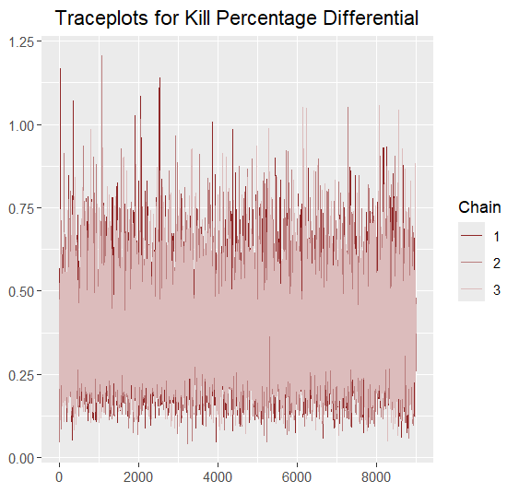
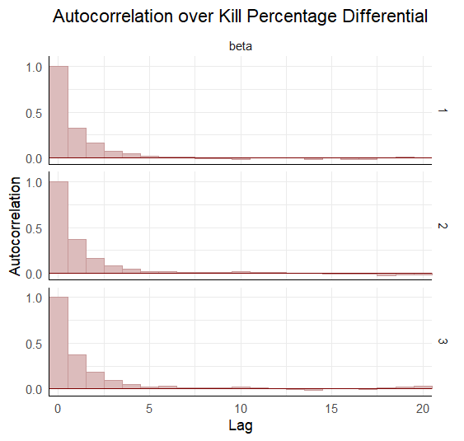
Model Checks
Autocorrelation dies out after approx. 5 periods
Trace plots show convergence and efficient sampling
Negative values are not sampled
Coefficient on Kill % ranges from around 0.1 to 0.7
99% interval plotted; 95% interval highlighted
Once again purely positive

Slide 14
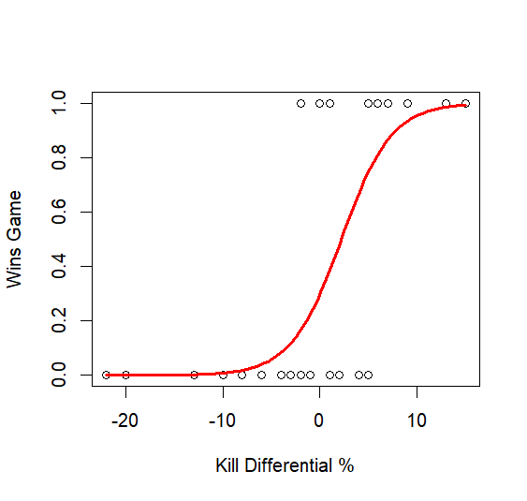
Logistic Sigmoid Curve
Plotting the stan output gives a logistic curve over the wins and losses
Wins = 1; Losses = 0
Kill diff. of 0 ≈ 40% chance to win
Changes in win likelihood happen between -10 and 10
Lowest win was a kill diff. of ≈ -2
Only wins with negative diff.
Notes:
2 wins at -2 differential

Slide 15
Model 3: Robust Normal Regression
Robust Linear Model of Good Game Jumps on Kill % Differential
Kill Differential ~ student_t(nu, X * beta, sigma)
Observations = 29; Iterations = 10,000; Chains = 3;
Priors: nu ~ Gamma(2,.1)
Ignorance prior used for beta
Jumps collected by Catapult IMUs within games
High Jumps for most positions; Medium for Setters; Liberos & Defensive Specialists excluded
Two games did not have catapult data (observations: 31 ➔ 29)
Notes:
Transition to predicting kill %
Since kill % is so valuable, predicting that instead
Inertial Measurement Units
Results were poor with Normal Distribution Prior
Linear regression was positive, stan was reporting negative

Slide 16
Stan Output
Good Jumps has an almost fully positive relationship with Kill diff.
95% interval crosses 0
Rhats equal to 1 for all parameters
n_eff is high for all parameters
Nu has a high point-estimate
Parameter | mean | se_mean | sd | 2.5% | 97.5% | n_eff | Rhat
Intercept | -43.34` | 0.25 | 23.83 | -89.96 | 4.08 | 8763 | 1
Good Jumps | 0.62 | 0.00 | 0.14 | -0.06 | 1.31 | 8765 | 1
Sigma | 8.66 | 0.01 | 1.38 | 6.34 | 11.74 | 12087 | 1
Nu | 22.16 | 0.11 | 14.04 | 4.43 | 57.05 | 15823 | 1

Slide 17
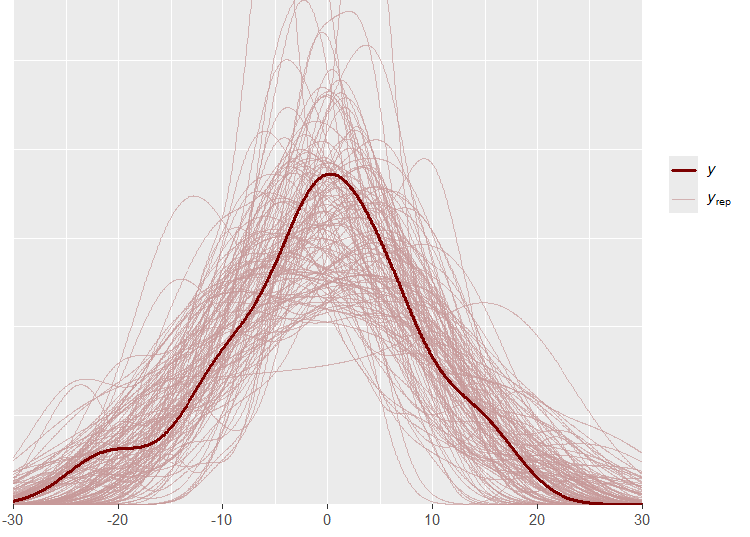
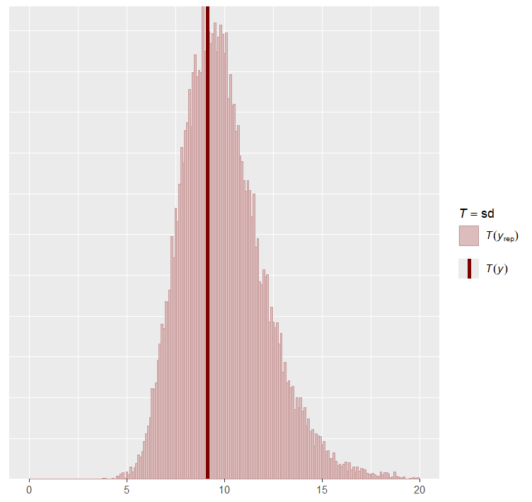
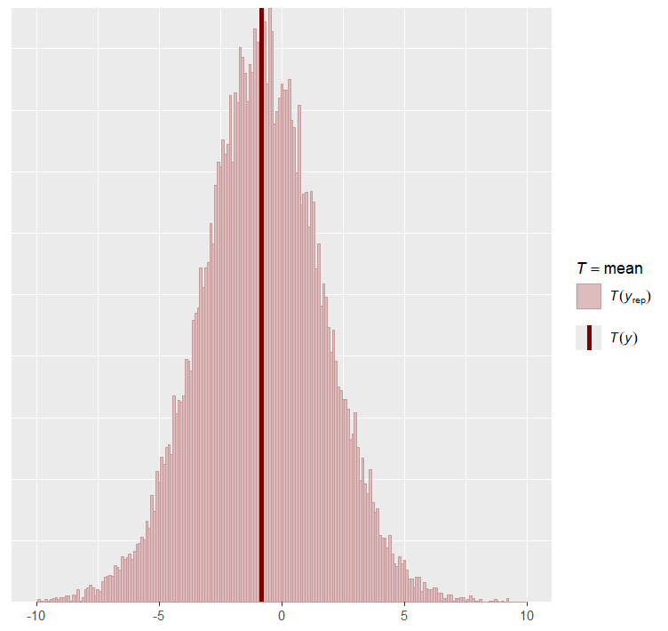
Posterior Predictive Checks
Generative data follows the normal distribution of the volleyball data
Spread of generative data explains high variance
Mean and standard deviation recovered well
Large spread for both of these variables
Max and Min also recovered
Notes:
Mean and sd have normal distributions
Reinforcement for choosing normal prior even tho it did not work

Slide 18
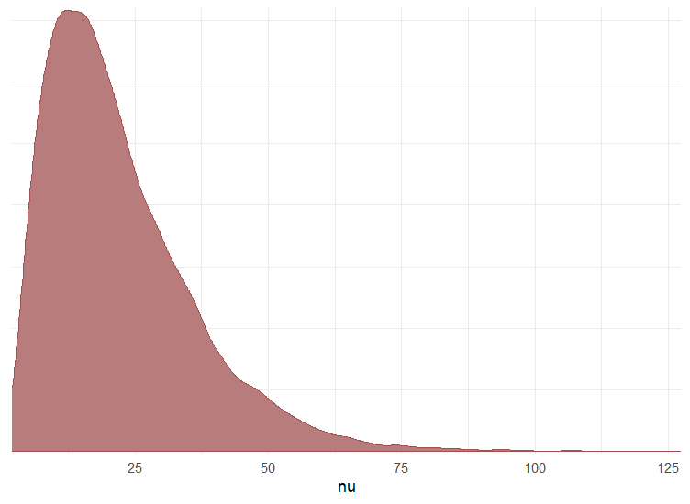
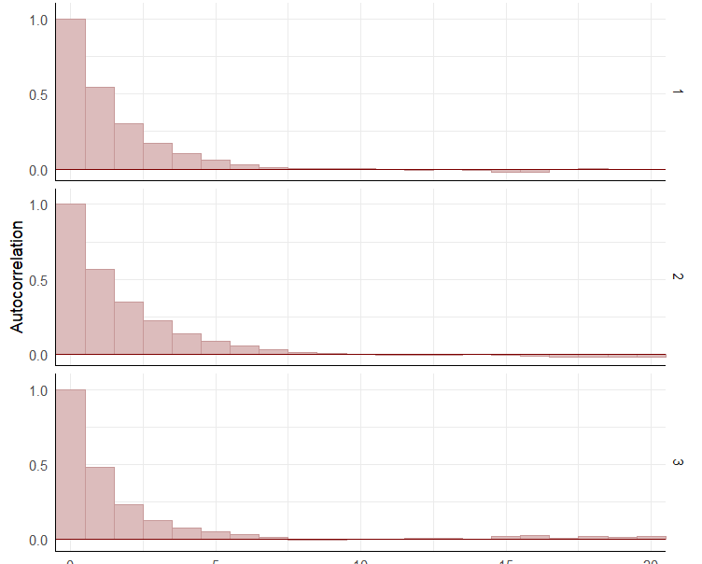
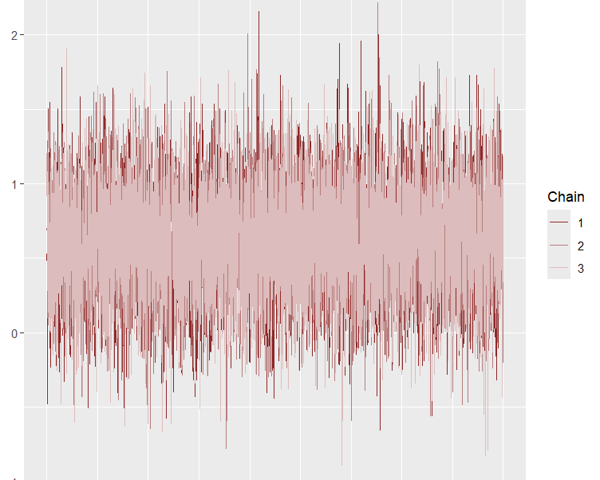
Model Checks
Trace plot shows efficient sampling
Samples over 0 regularly
Autocorrelation dies out after approx. 5 periods
Nu contains large values (Robust)
Indication of student-t converging to normal distribution
Notes:
High nu = robust regression

Slide 19
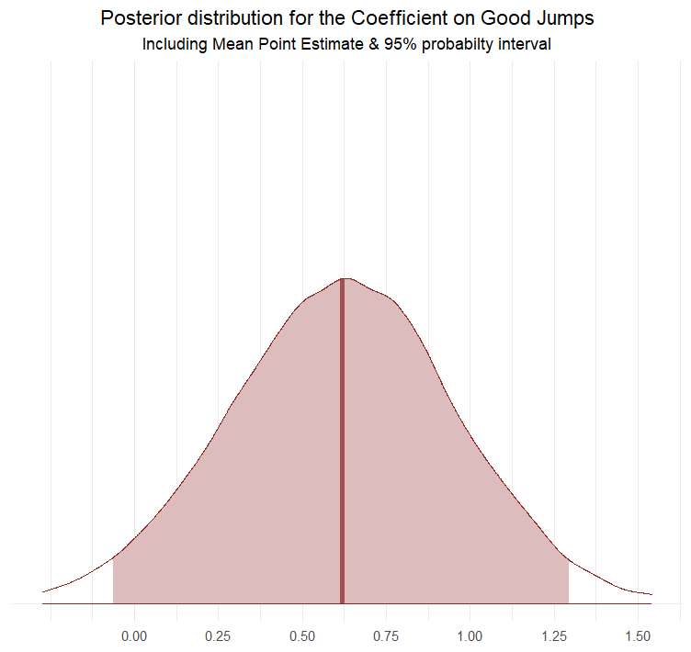
Good Jumps Density Curve
Coefficient on Good Jumps ranges from -0.1 to 1.3
90% interval does not contain negative values
Applied setting not a lab setting
Jumping is all but required to get a kill
Kill Diff adds an interesting angle
Team could be jumping higher than ever, and still get outperformed
Notes:
Large Range
Uniqueness of Sports
Jump and playing better than ever and other team could still outperform
Applied Setting and Bayesian Framework
While kill diff helps account for many things, some downfalls
Opponent could get high kill % no matter what you do

Slide 20
Model 4: Robust Normal Regression
Robust Linear Model of Practice Good Jumps & Player Load on Kill % Differential:
Kill Differential ~ student_t(nu, X * beta, sigma)
Observations = 29; Iterations = 10,000; Chains = 3;
Priors: nu ~ Gamma(2,.1);
Ignorance prior used for beta
Two practices did not have catapult data (observations: 31 ➔ 29)
Only practices analyzed were the practices the day before a game
Notes:
Results were poor with Normal Distribution Prior
Linear regression was positive, stan was reporting negative
Player Load = Effort exerted
Calculated using accelerations

Slide 21
Stan Output
Parameter | mean | se_mean | sd | 2.5% | 97.5% | n_eff | Rhat
Intercept | -31.58 | 0.17 | 18.02 | -66.57 | 4.17 | 11008 | 1
Good Jumps | 0.18 | 0.00 | 0.20 | -0.21 | 0.58 | 13859 | 1
Player Load | 5.95 | 0.03 | 3.93 | -1.70 | 13.80 | 13580 | 1
Sigma | 8.13 | 0.01 | 1.47 | 5.56 | 11.33 | 12916 | 1
Nu | 18.96 | 0.10 | 13.62 | 3.29 | 53.88 | 17761 | 1
Much more inconclusive results
Both Good Jumps and Player Load cross into the negative values
Rhats equal 1
n_eff values are sufficiently large

Slide 22
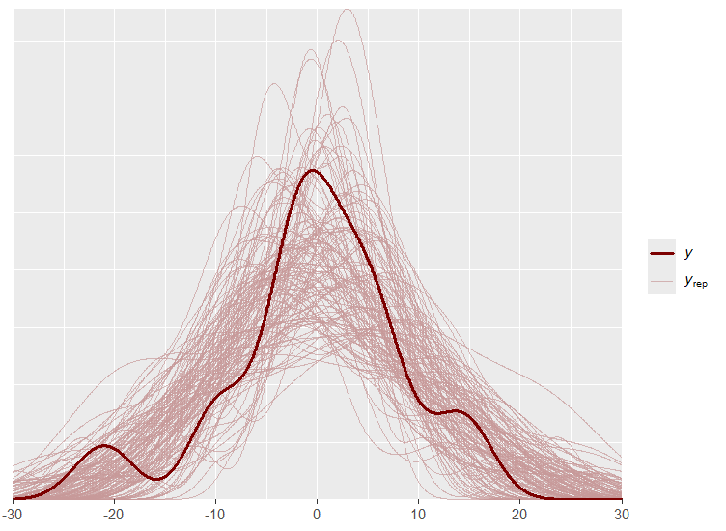
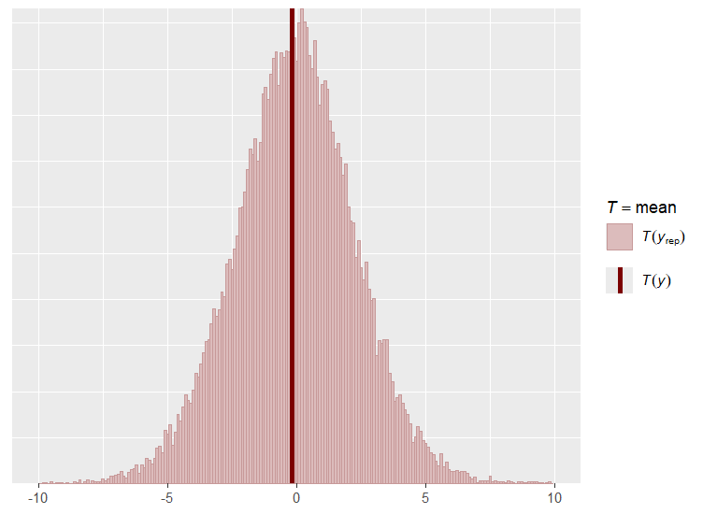
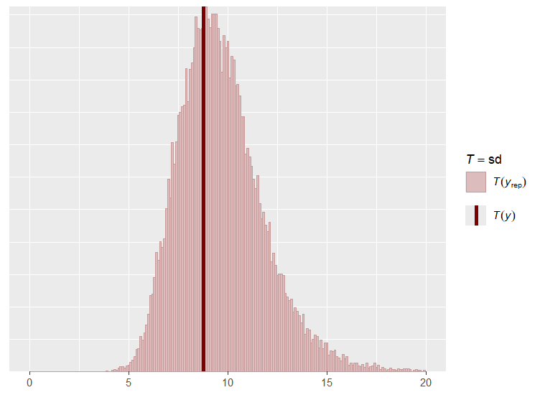
Posterior Predictive Checks
Generative data follows the somewhat normal distribution of the volleyball data
Spread of generative data explains high variance
Weird shape of Utah data because of outliers and low amount of data
Mean and standard deviation recovered well
Large spread for both
Max and Min also recovered

Slide 23
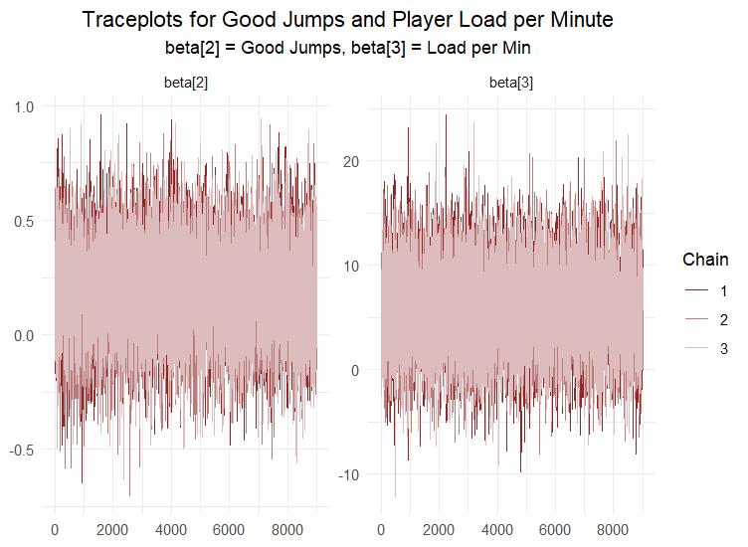
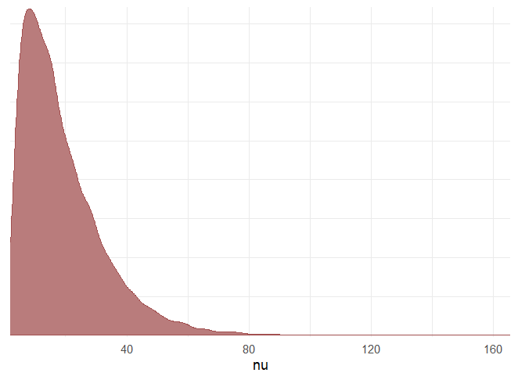
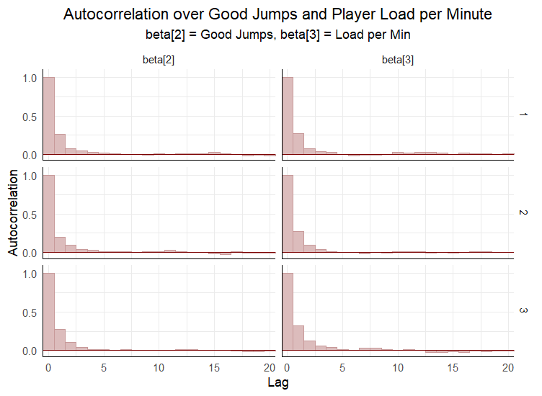
Model Checks
Both trace plots show efficient sampling
Both sample negative values regularly
Autocorrelation dies out almost immediately
Nu contains somewhat large values
Indication of student-t converging to normal distribution
Not as large as the previous model

Slide 24
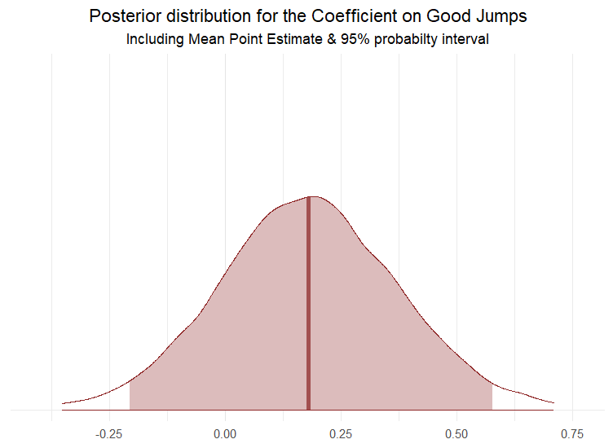
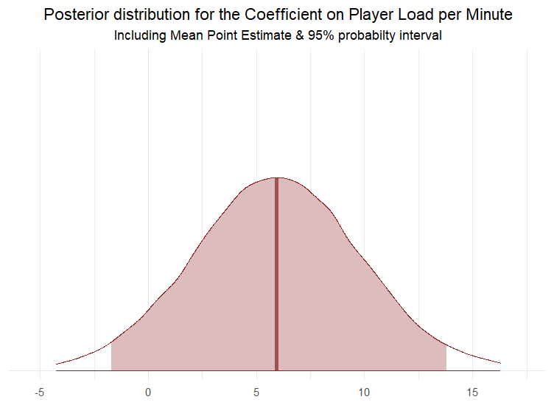
Density Curves
Negative values indicate uncertainty
Coefficient on Good Jumps ranges from -0.2 to 0.6
Coefficient on Player Load ranges from -2 to 13
Practice effort leads to improvements in kill differential; up to a point
90% intervals are mostly positive
Fully for Player Load per min
Notes:
Large Range
Uniqueness of Sports
Jump and playing better than ever and other team could still outperform

Slide 25
Limitations
Data is collected in an applied setting
Lots of confounding variables that cannot be accounted for
Small dataset size
Analysis would be more concrete if multiple seasons were compared

Slide 26
Conclusions
Kill percentage has the largest impact on winning volleyball games
Kill % differential encapsulates offensive and defensive performance
Also has a large impact on winning
The Bayesian framework and data collection in an applied setting allow for relaxed probability intervals
Good jumps in a game correlate with a higher kill differential
Effort in practice the day before a game has an undetermined impact on kill differential

Slide 27
Sources
Lots of advice from the University of Utah Applied Health and Performance Science Team as well as strength coaches, and information that I have heard indirectly from the coaching staff
"Women's Volleyball Statistics." NCAA.com, National Collegiate Athletic Association, https://www.ncaa.com/stats/volleyball-women/d1
"Logistic/Probit Regression." Stan Users Guide, Stan Development Team, https://mc-stan.org/docs/stan-users-guide/regression.html#logistic-probit-regression.section.
"Catapult Metric Descriptions." PlayerTekPlus, Catapult Sports, https://playertekplus.catapultsports.com/.
"OpenAI Chat." OpenAI, OpenAI, https://chat.openai.com/?model=text-davinci-002-render-sha.
PubMed Central, National Center for Biotechnology Information, U.S. National Library of Medicine, https://www.ncbi.nlm.nih.gov/pmc/articles/PMC7052708/#:~:text=Catapult%20Sports%20proposed%20that%20PL,et%20al.%2C%202011.
Grammarly, Grammarly Inc., https://www.grammarly.com/.
University of Utah Writing Center, University of Utah, https://writingcenter.utah.edu/.
"Stan User Guide" Stan, Stan Development Team, https://mc-stan.org/.

Slide 28

Questions?

